Slide 1
Inbound, PR & HubSpot
Connecting the Dots

Slide 2
An Introduction
CyberInt – Protection Beyond the Perimeter
A solutions for a variety of threats beyond the perimeter. From protecting our customers digital brand to identifying fraudulent activities and protecting their businesses from cyber attacks.
I’m the VP Marketing @ CyberInt
Mentors/Advisor – The Junction, CyberX, Portnox, inpedio…

Slide 3
Our Marketing Stack (Prior to HubSpot)

Slide 4
CyberInt in the Media
Wetherspoon hack is four times bigger than TalkTalk
Citrix hit by 'altruistic' Russian hacker w0rm
Social Media has become one of the top risks for business today
Dec, 2015
Jan, 2016
Dec, 2015
Jan, 2016
Mar 2016
At least 10 major loyalty card schemes compromised in industry-wide scam
Faithless fans have personal data stolen after band's website hacked

Slide 5
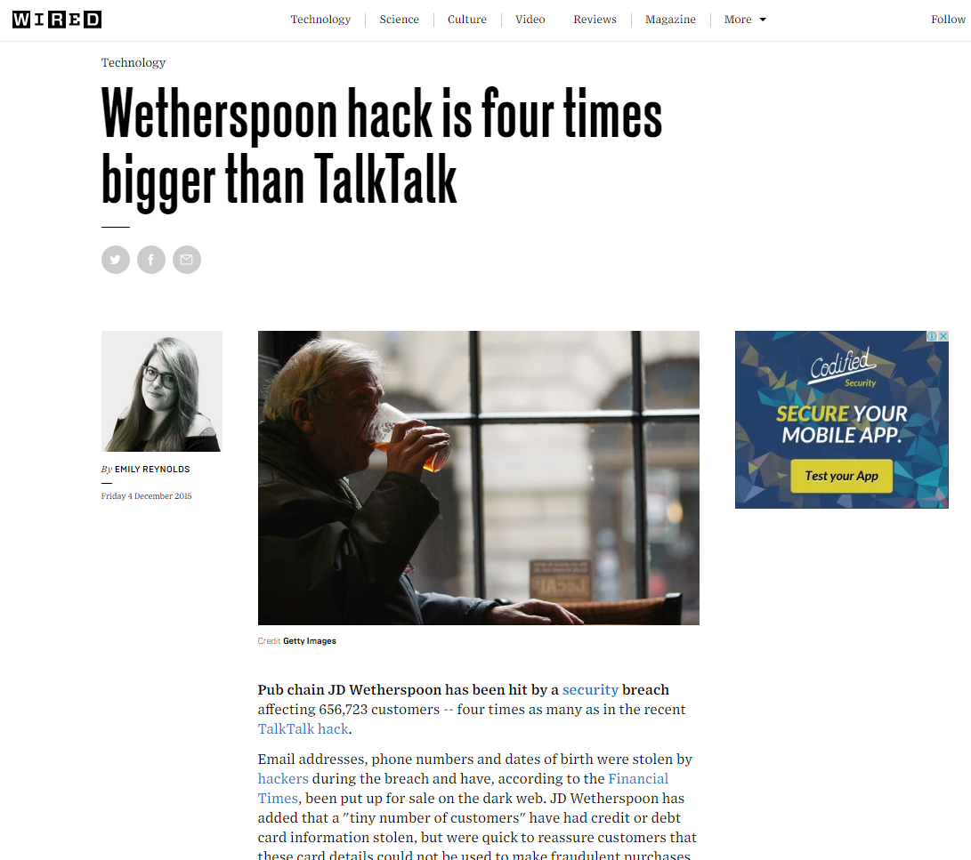
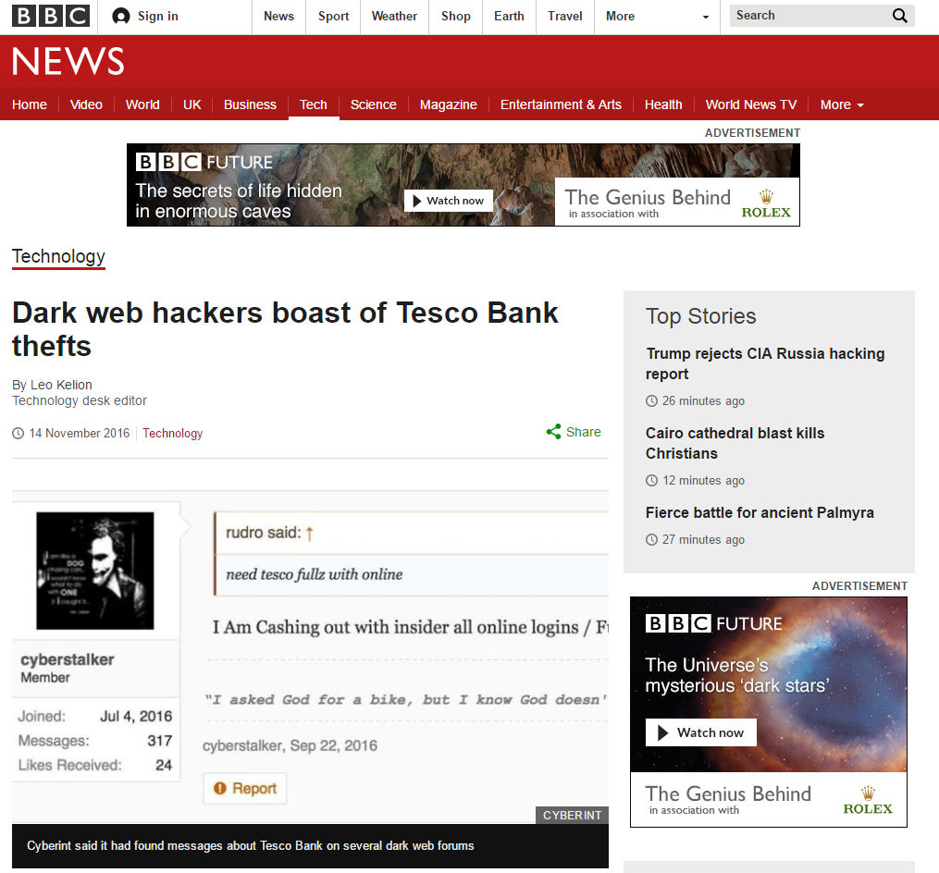
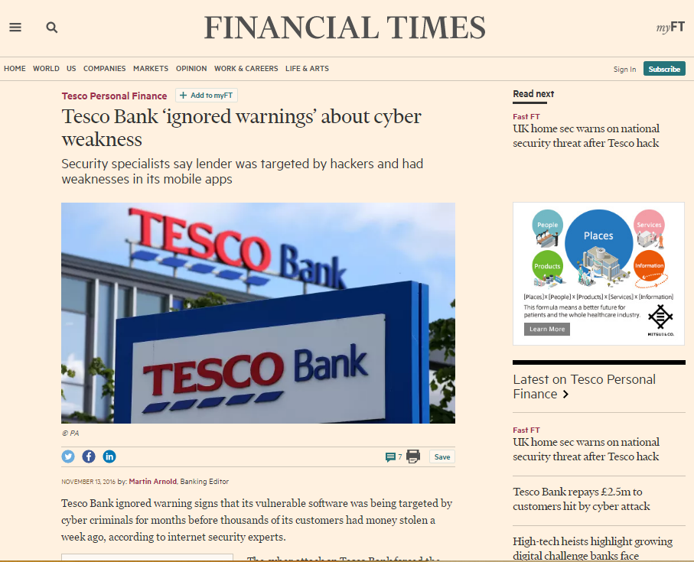
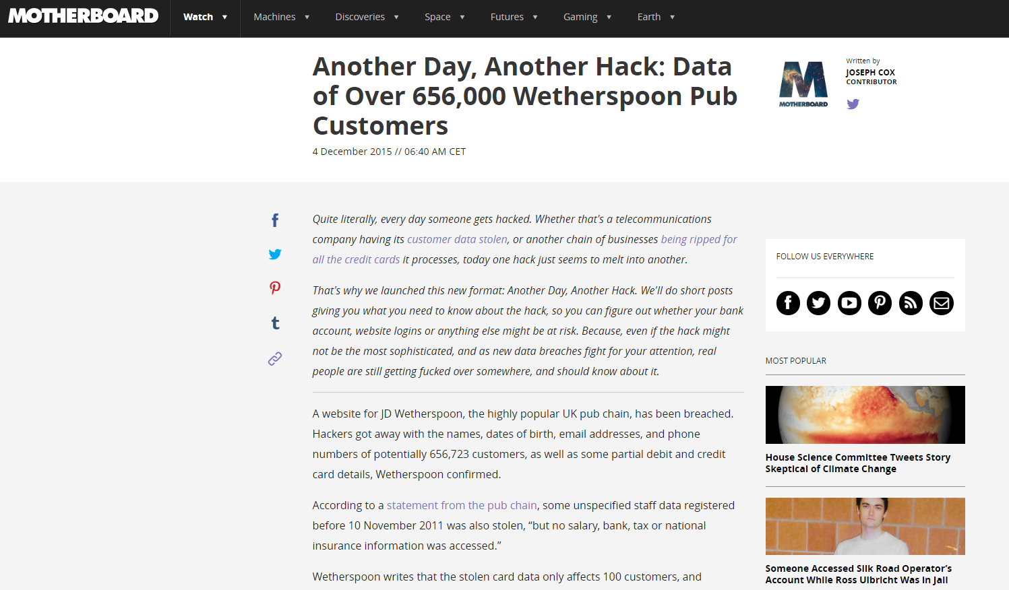
Recent Headlines
Notes:
FT Published date: November 14th
BBC Published date: November 13th

Slide 6
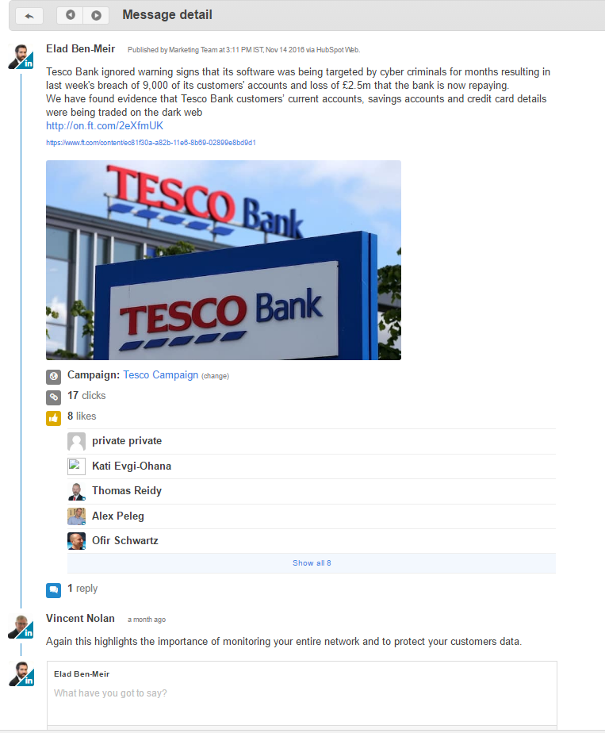
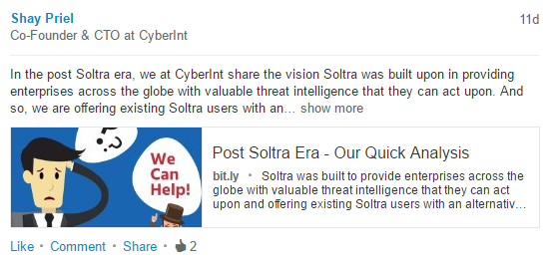
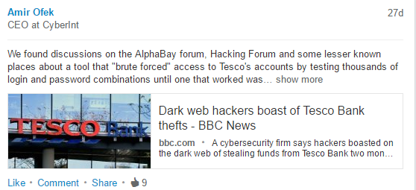
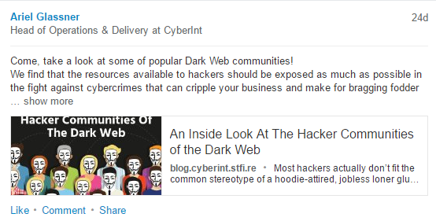
We All Chip-In

Slide 7
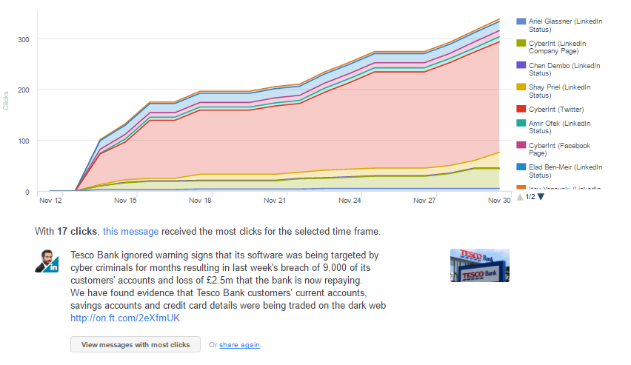
And… HubSpot Tracks it All

Slide 8
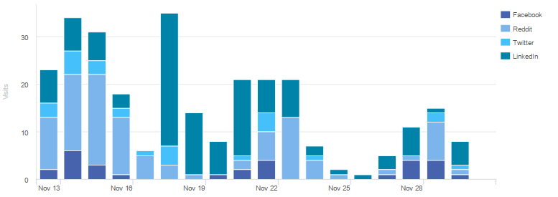
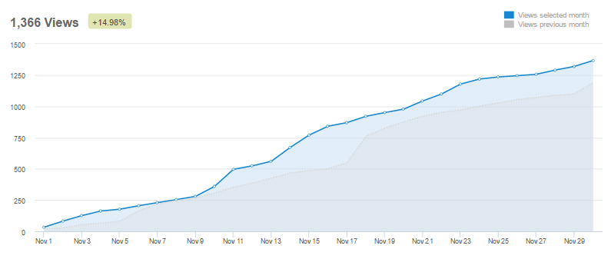
Stats Following the Tesco PR
Social Messages Published : 33
Website traffic top pages:
Blog Views : +15%
Homepage visits: 1845
Careers Page visits: 325
November Total: 3549
October Total: 1533

Slide 9
Organic Search Grew Substantially

Slide 10
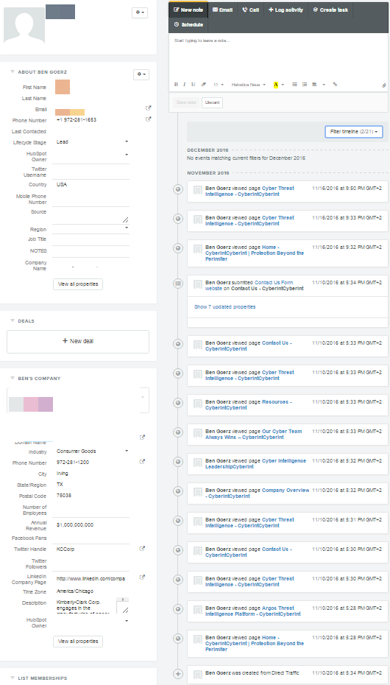
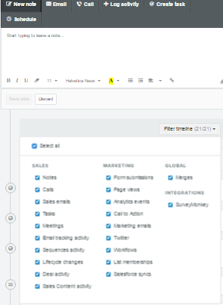
HubSpot – Marketing Perspective

Slide 11
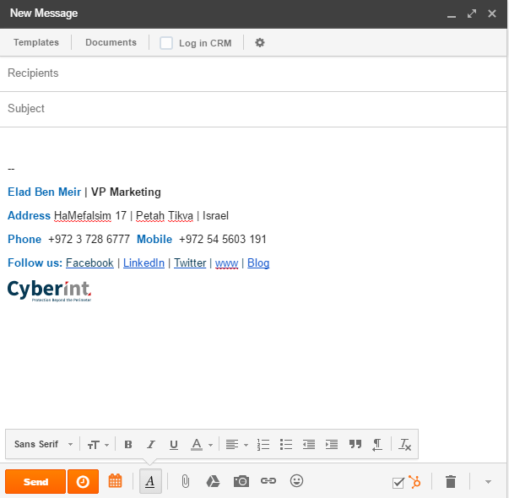
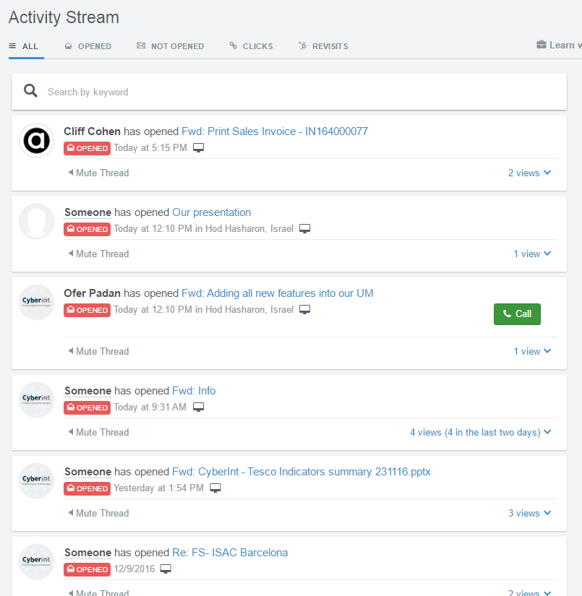
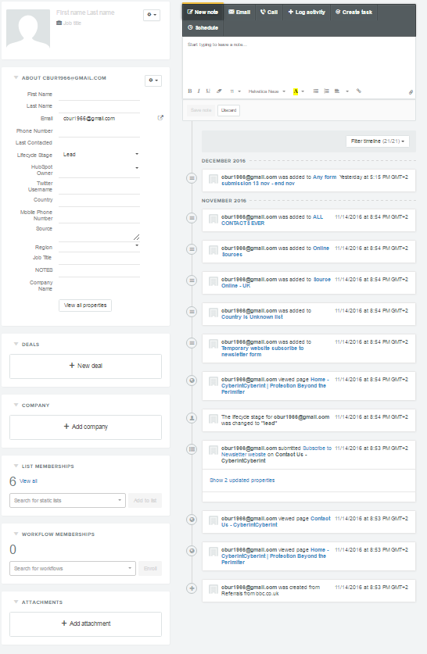
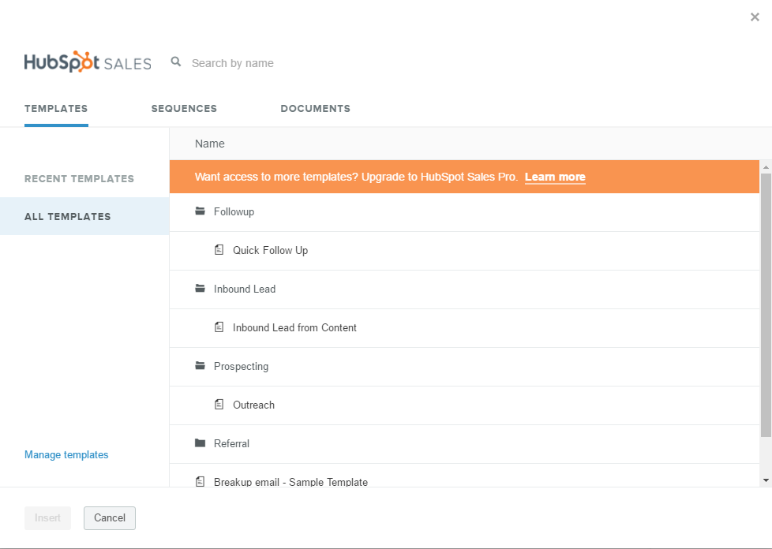
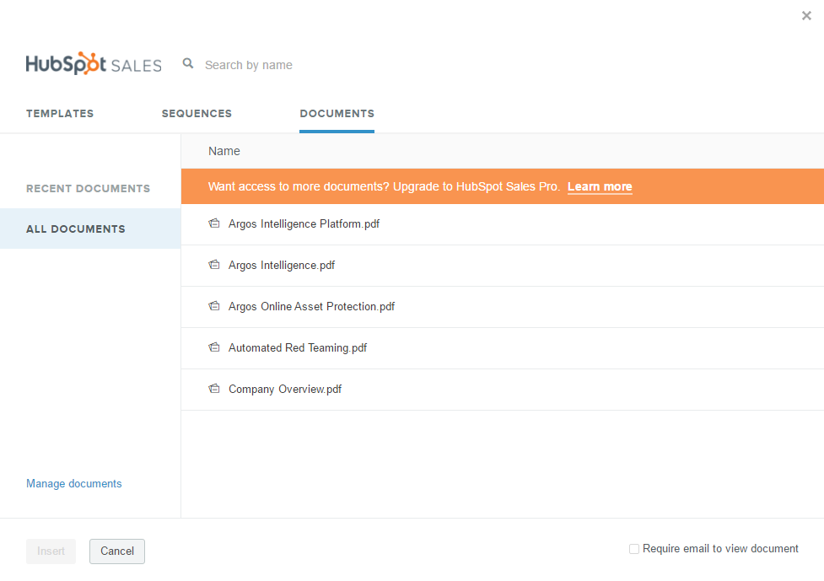
HubSpot – Sales Perspective

Slide 12
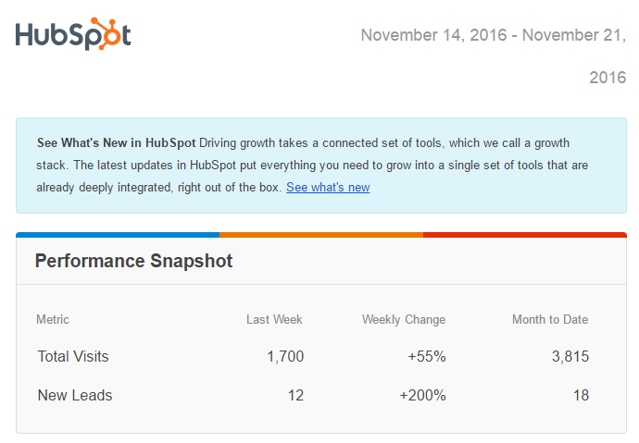
Overall Campaign Results
11 New Blog Subscribers
2 Premium/Gated Content Downloads
6 MQLs
1 Demo Request

Slide 13
Thank You.

