Slide 1
Grill the
Experts!
June 2017

Slide 2
Presenting today
Ayal Tirosh & Nancy Shapira, Gartner
Ofer Schreiber, Partner, YL Ventures
Dori Harpaz, VP Marketing, Secdo
Lior Katz, Inbound Marketing Manager, Marketing Envy
Notes:
Outsource marketing team – 1- stop shop

Slide 3
Sooo, I’m not Amit Lavi
Notes:
Outsource marketing team – 1- stop shop

Slide 4
Marketing Envy Founders
Over 30 <gulp> years combined experience with tech start ups and multi-national brands
Google, Facebook, Ubuntu, Fuji-Xerox, HP Scitex, Cloudyn, BlazeMeter, DMG, ICQ, Comilion, Coronet, CyberInt, Portnox, Showbox, Foter, Clicktale, SecuredTouch, illusive networks, Secdo, Panoply, Aqua Security, EverCompliant,
SignifAI, PlainID
Billy Cina
Amit Lavi
Billy@MarketingEnvy.com
@billycina
Amit@MarketingEnvy.com
@amitlavi
Notes:
Outsource marketing team – 1- stop shop

Slide 5
Marketing Services for B2B Tech Companies
Inbound & Outbound Marketing by Marketing Envy. Because nothing works alone, there are no silver bullets, quick hacks or magic tricks.

Slide 6
Customers Include

Slide 7
Reaching Your
Target Audience:
How successful cybersecurity companies get it done

Slide 8
Solid SEO,
Content marketing
& Social Media Strategy

Slide 9
TIP 1:
Organic is Key
SEO Optimization
Keyword Research
Notes:
If you oversaturate a p1.age with too many keywords, the page will lose its importance and authority because search engines won’t have a clear idea of what the page is about.
1. Pick a list of around 20 keywords you’ll focus on when optimizing your website.
2. For each page, blog or landing page pick one primary keyword to focus on.
3. Place your primary keywords in your headline and sub-headline
4. Include the keywords in the body content but don’t use them out of context. Make sure they are relevant with the rest of your content.
5. Include keywords in the file name of images (e.g. mykeyword.jpg) or use them in the ALT tag.
6. Include the keywords in the page URL.

Slide 10
Tools to use for keyword research:
…
keyword planner

Slide 11
TIP 2:
Yes, More
Content Equals
More Leads
The more content, offers, and landing pages you create, more opportunities to generate more leads.
Notes:
According to a recent marketing benchmarks report, companies see a 55% increase in leads by increasing landing pages from 10 to 15. The more content, offers, and landing pages you create, more opportunities to generate more leads for your business.

Slide 12
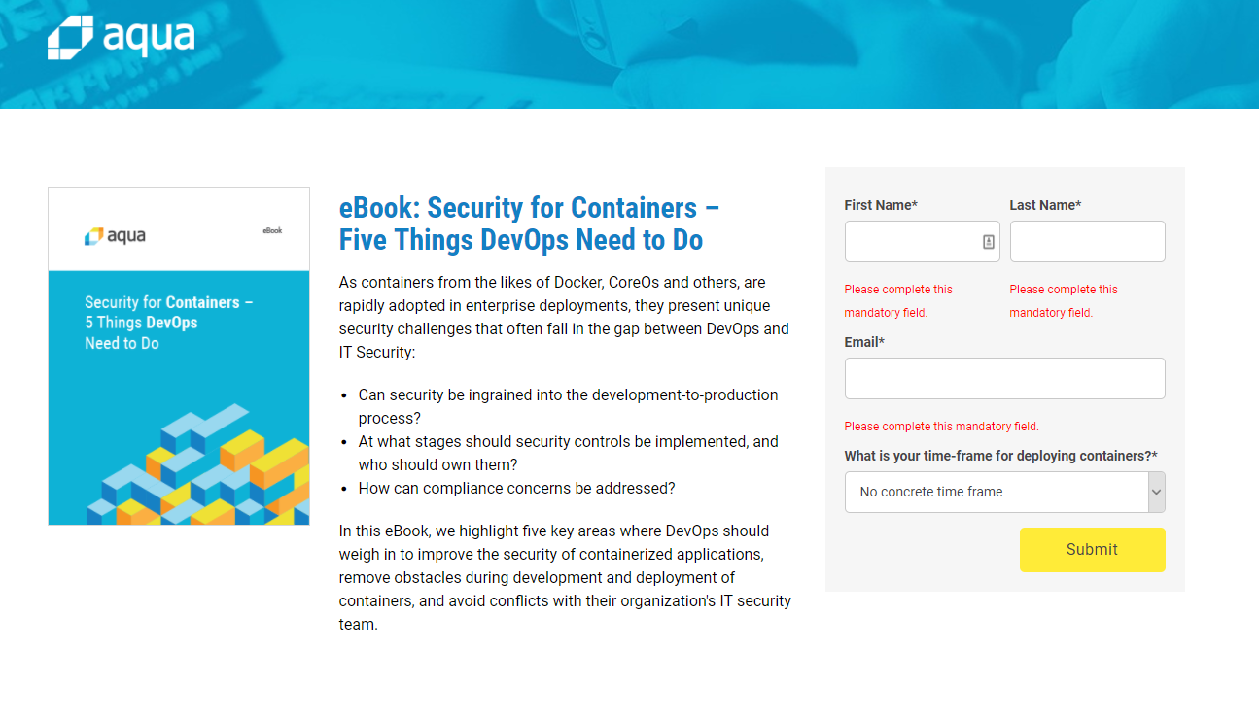
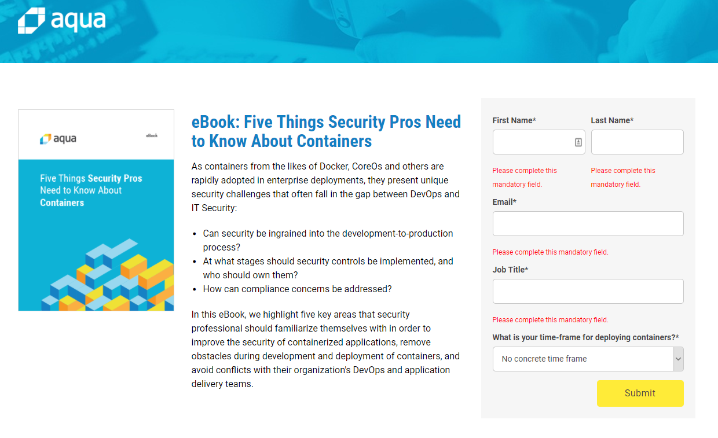
Repurpose Your Content for Different Personas
…
For DevOps
For Security

Slide 13
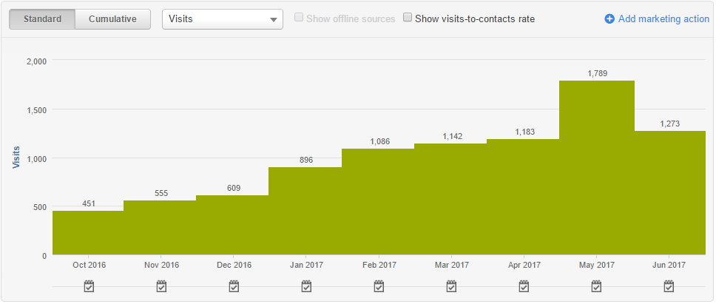
…
Blogging That Brings in the Leads
Companies that blog 6-8 times per month double their lead volume.
Know your audience
Set SMART KPIs
Set relevant CTAs
Notes:
Don’t just blog about yourself/your product./your company – become the go to resource for ecosystem news and insights (this you will get from your keyword research)
Know your goals - Write blogs for every stage in the buyers journey
Set measurable KPIs
Make sure your CTAs are relevant to the blog content

Slide 14
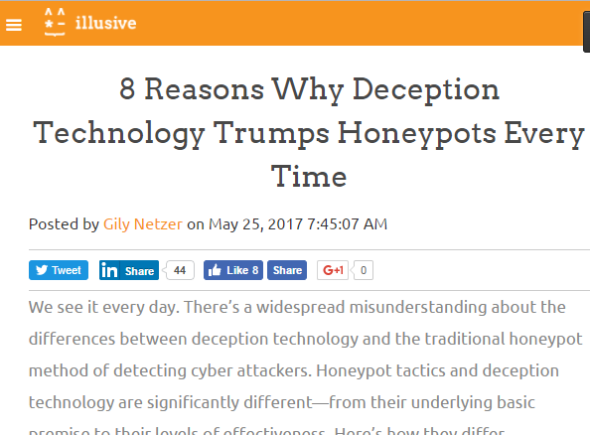
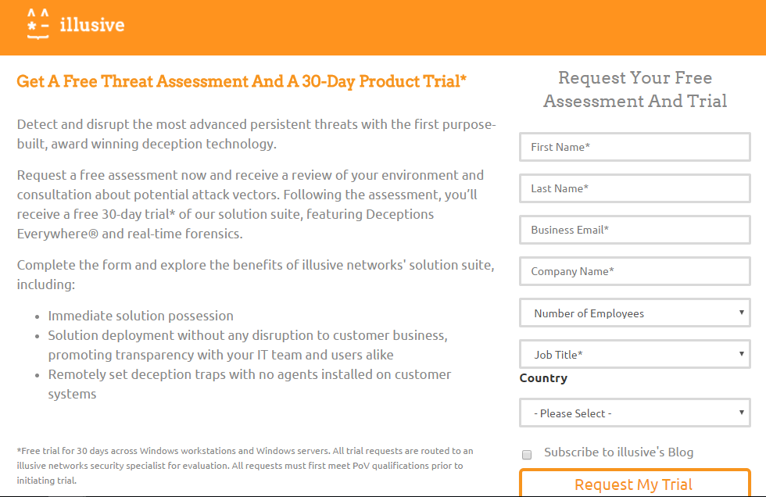
…
Create Offers For Different Buying Stages
Early
Middle
Ready
Early
Middle
Early
Middle
Ready
Ready
Notes:
The most common offer I see on most websites is “Contact Us.” Sure, you want all your prospects to talk to sales, but not everyone is ready. As you know, buyers are more likely to do their own research before even engaging with a sales rep. And, every prospect is at a different stage of exploration. Some may need more education than others. That’s why it’s important to develop different offers at different buying cycles.
Someone at the top of the buying cycle may be more interested in an informational piece like a guide or ebook, whereas someone more committed at the bottom of the cycle might be more interested in a free trial or demo. You don’t need to pick and choose; create offers for each phase, and include a primary and secondary CTA to these offers on various pages throughout your site. For Example, a company such as Portnox, A network security company created the following content for each stage:
Early stage: a blog post detailing the differences between honeypots and deception technology
Middle Stage: Whitepaper about how deception works, with an example of the product
Ready Stage: Landing page to sign up for threat assessment and free

Slide 15
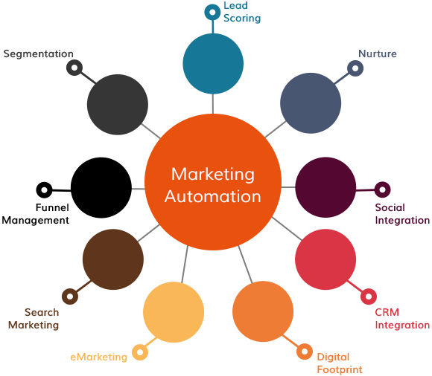
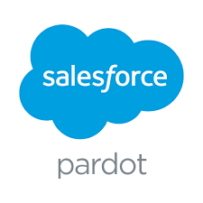
Marketing Automation for Any Size Org
TIP 3:
Marketing automation is about making sure you don’t miss a single lead and each one is nurtured as much as possible.
Notes:
Automate Content Discovery
Automate Content Distribution
Social media distribution
Landing Page platforms
Email Drip
Bring Sales and Marketing closer.
Analytics

Slide 16
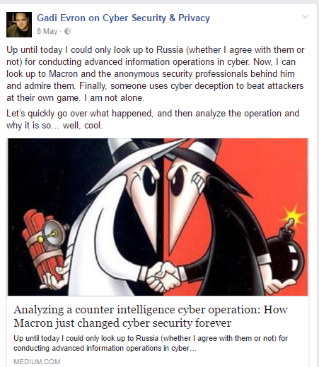
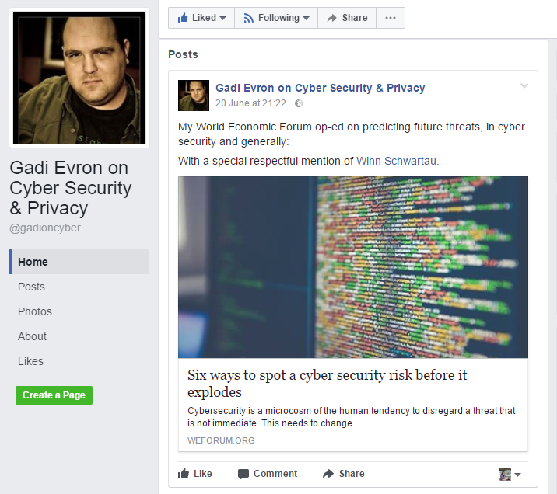
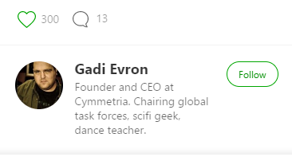
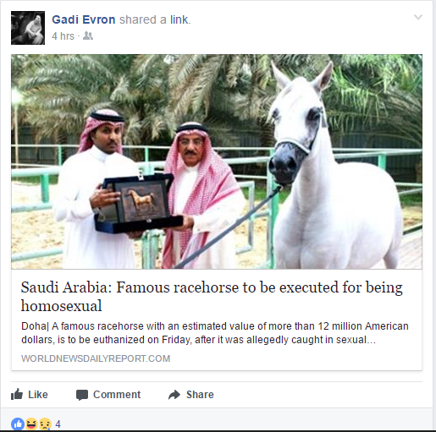
TIP 4:
Become the Influencer
Be your prospects’ go to resource for ecosystem insights.
Build a loyal following.
Remember, social media is a dialogue.
Influence connections for content sharing.
Notes:
Build a loyal following. Building a relationship with potential customers is a critical first step. Social media connections are really about people-to-people, not always company-to-individual. Get to know your audience online, communicate and share information. In order to generate leads, you need to have human interaction with others.
Remember, social media is a dialogue. Companies that only use social media to blast out messages about themselves aren’t using social channels effectively. The goal is to interact with others and be helpful. When you share content on social media, don’t always post something that relates to your company. Share links to other interesting things you’ve found online. People will be very thankful you are noticing their work, too!
Influence connections for content sharing. Publishing and sharing content that directs traffic to targeted landing pages is the single biggest lever to increase lead generation through social media. Share your new content offers by posting links to landing pages, and in addition, share blog posts, discounts, and other great resources.
Social media isn’t just for liking funny pictures or tweeting what you ate for breakfast. Here are some great tips for generating leads on social networks.

Slide 17
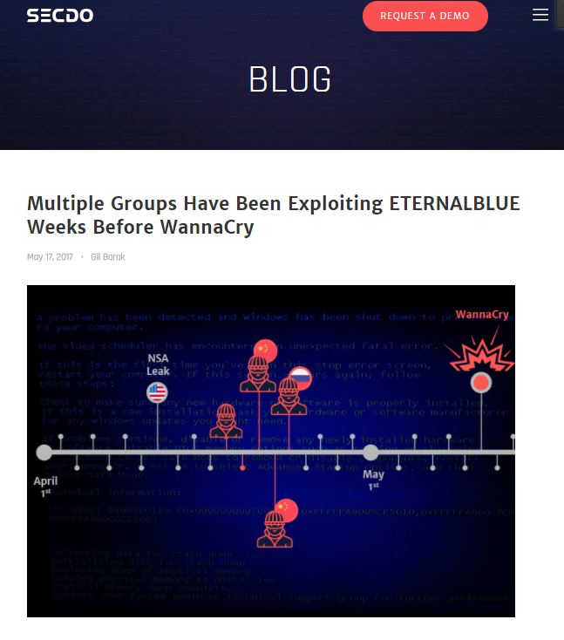
Kaspersky
TIP 5:
Leverage Newsjacking WannaCry anyone????
CyberInt
Secdo
Cybereason

Slide 18
PPC
Driving Leads

Slide 19
TIP 7:
PPC Boost
Notes:
Adwords - Use Google AdWords to promote your content offer on broad and general keywords but make sure to create ads for direct demo requests for keywords like Threat Feed Providers or Firewall solutions.
FB - Excellent for reaching DevOps, Network and System admins. Remarketing on Facebook is a must for all target groups. Drives great traffic for the awareness stage.
LI - The ‘Go To’ platform for B2B but the cost per click is high. This is the only paid media to reach CISOs (and other C-levels) but must be accompanied by high value, helpful content. Use remarketing to convert to lead.
TW - Great for traction and engagement . Make sure to engage with influencers after acquiring them. Remarketing works as well, but mostly on Desktop.

Slide 20
TIP 8:
PPC and
A/B Testing
Traffic
50%
50%
Winner
Version A
Version B
20% Conversion Rate
25% Conversion Rate
Notes:
While this isn’t a channel per say, it is a great way to increase leads across all channels and tactics.
A/B testing can be used in calls-to-action, landing pages, email marketing, advertising, and more.
A/B testing your landing pages and other assets can help you generate up to 40% more leads for your business.
When done correctly, A/B testing can provide a huge competitive advantage for your company.

Slide 21
Nothing Works Alone
SEO, Content Marketing & Social Media
Multi-channel PPC
Marketing Automation
Creative Messaging
Notes:
If you oversaturate a p1.age with too many keywords, the page will lose its importance and authority because search engines won’t have a clear idea of what the page is about.
1. Pick a list of around 20 keywords you’ll focus on when optimizing your website.
2. For each page, blog or landing page pick one primary keyword to focus on.
3. Place your primary keywords in your headline and sub-headline
4. Include the keywords in the body content but don’t use them out of context. Make sure they are relevant with the rest of your content.
5. Include keywords in the file name of images (e.g. mykeyword.jpg) or use them in the ALT tag.
6. Include the keywords in the page URL.

Slide 22
Thank You!
www.MarketingEnvy.com Lior@MarketingEnvy.com

